Slide 1
Functions of Several Variables

Slide 2
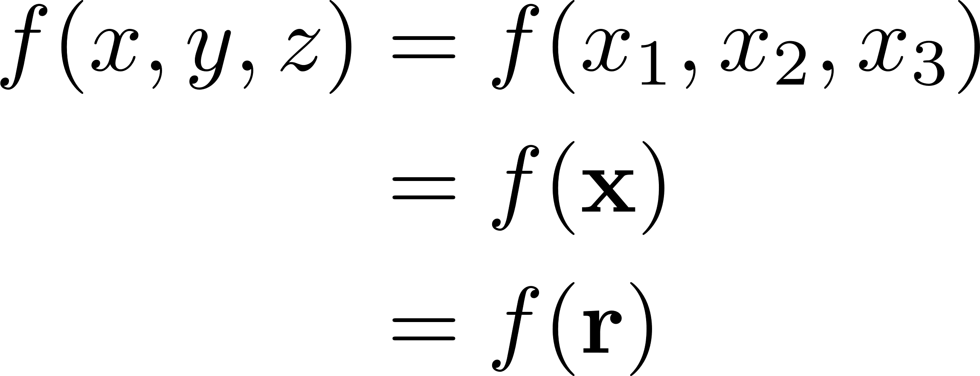
Notation

Slide 3
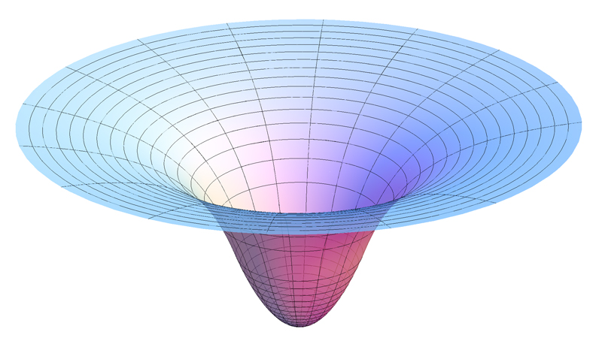
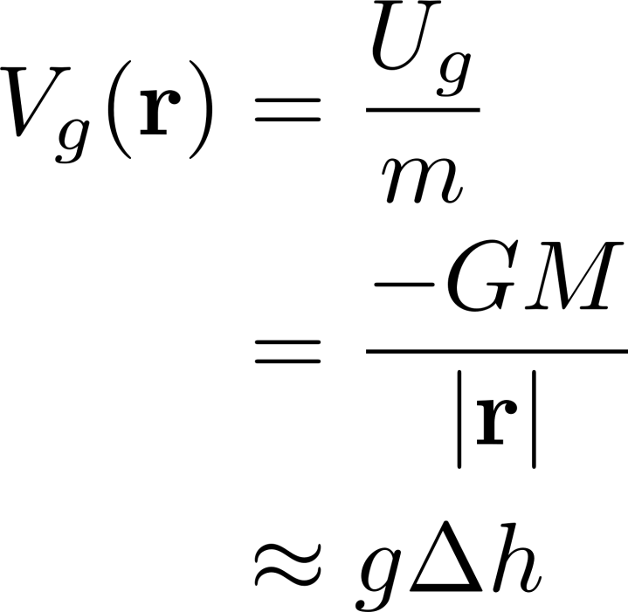
Gravitational Potential

Slide 4

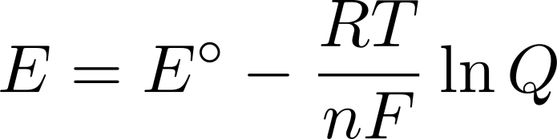
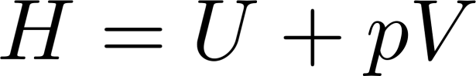

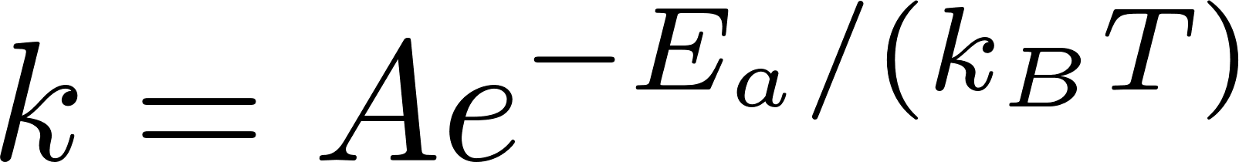

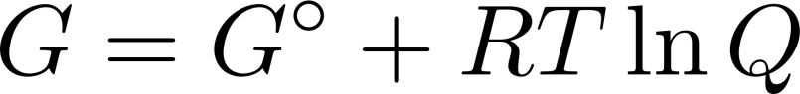
In Chemistry

Slide 5
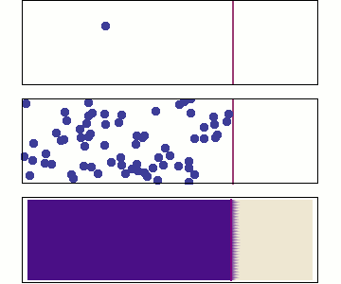
Diffusion
Notes:
Grad = 0 everywhere as t goes to infinity, Fick’s laws – can’t show Fick’s laws yet though…. Awkward.

Slide 6
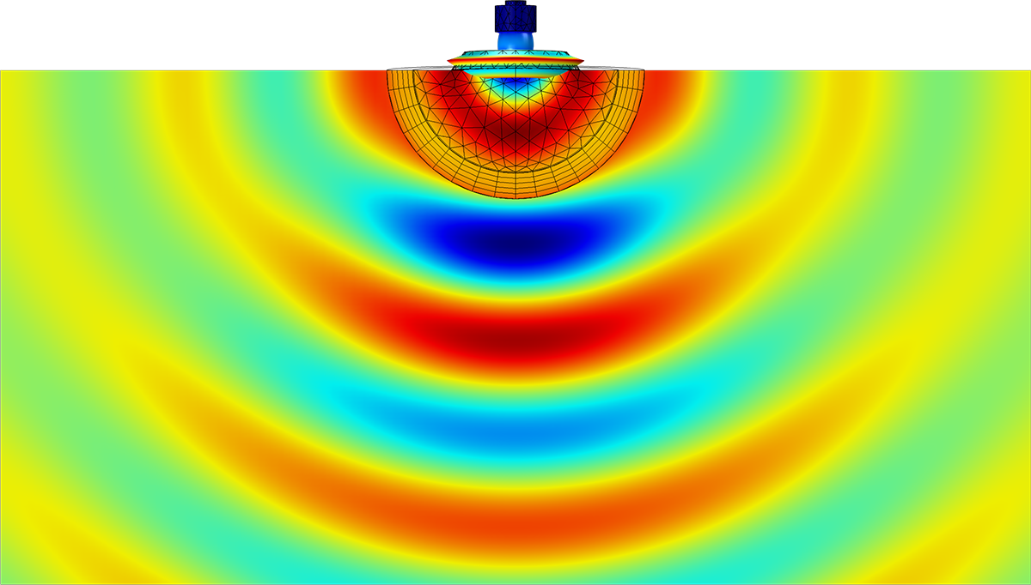
Acoustic Pressure

Slide 7
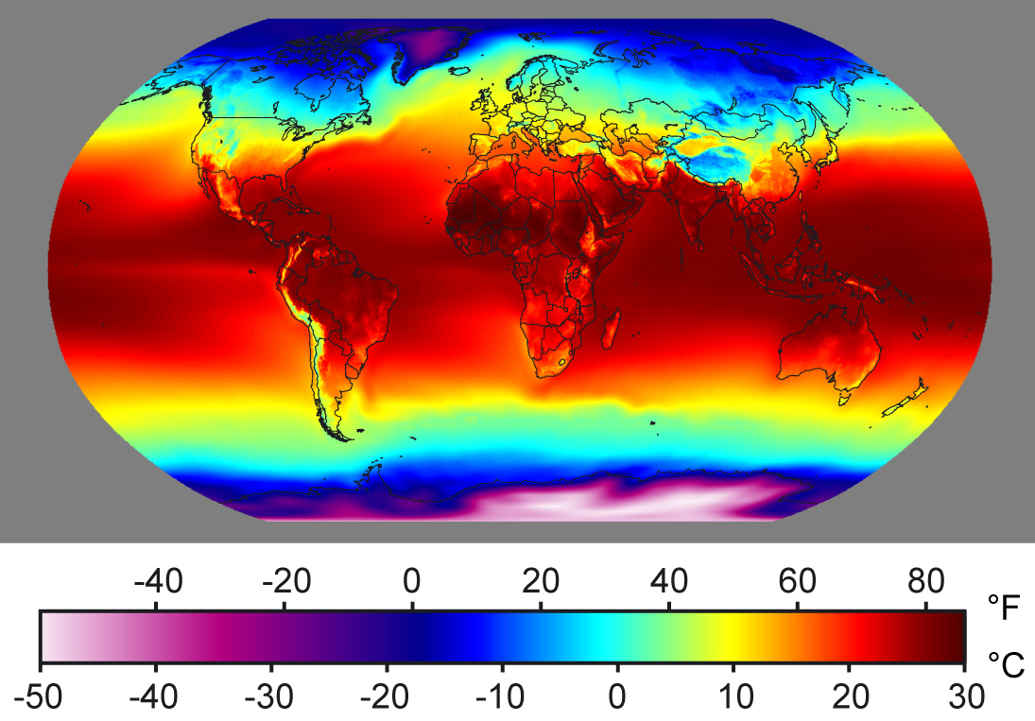
Temperature

Slide 8
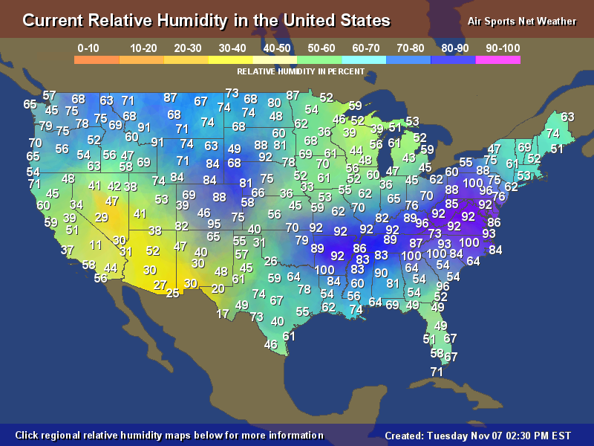
Humidity

Slide 9
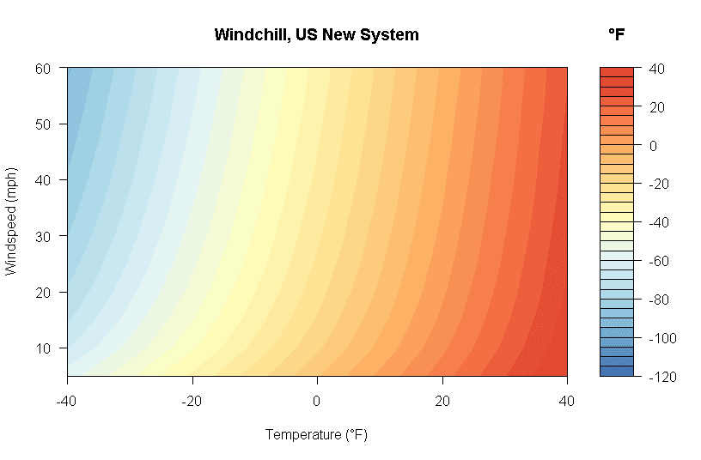
Wind Chill

Slide 10
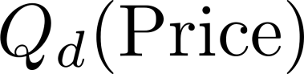
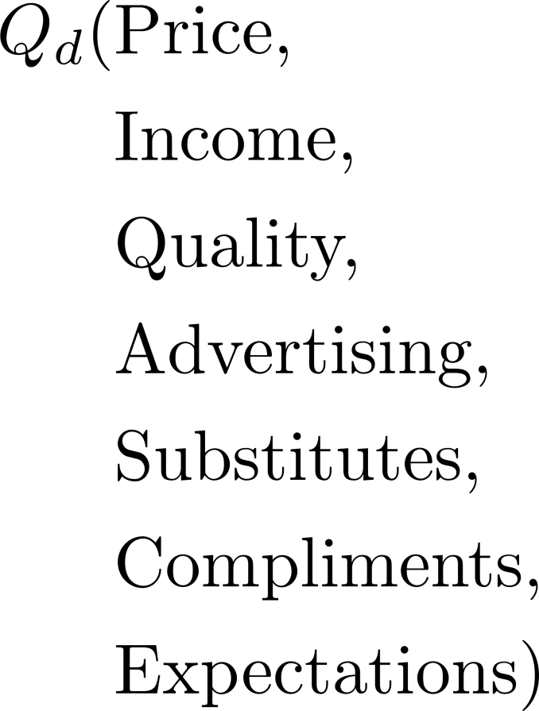
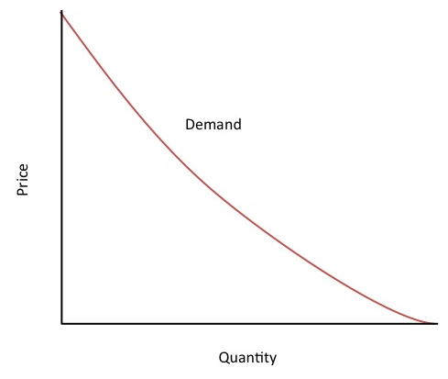
Economic Demand
Notes:
And supply too. Limits/continuity (kind of) since quantity (and price, etc.) must be discrete, but we model them with continuous functions

Slide 11
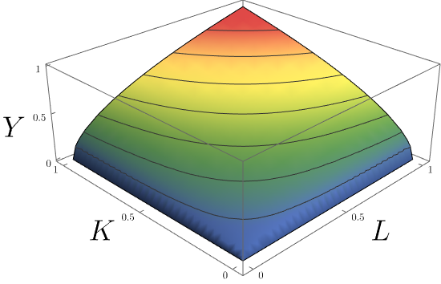
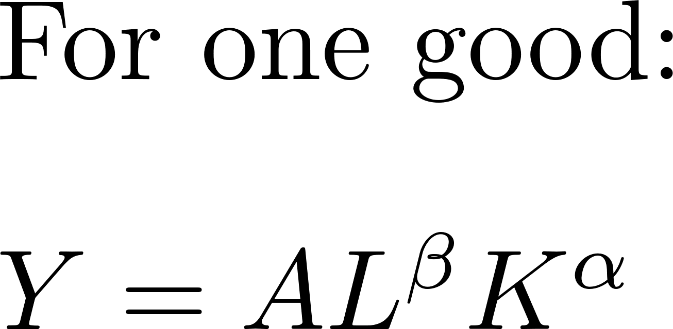
Cobb-Douglas Production

Slide 12
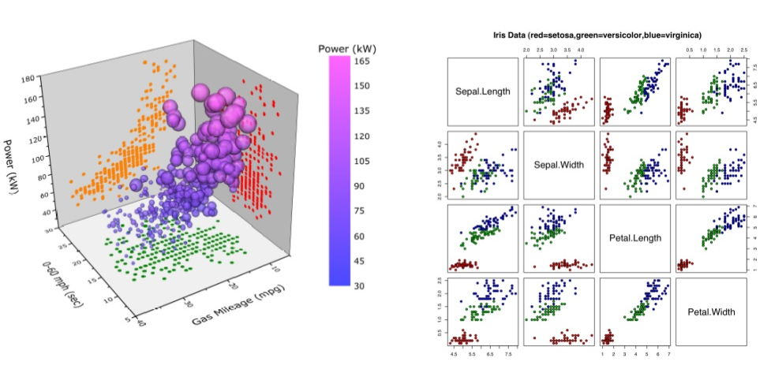
Machine Learning
Notes:
Objective of machine learning, in most basic sense, is to describe relationship between data with LOTS of variables.
In most basic type of machine learning (support vector machine), data with many, many parameters is fed in, and sorted into “feature space”. Then, feature space is split into two regions to distinguish between two types of data (e.g. black/white pictures).This basic principle is extended for most other, more complex, types of machine learning.
Applications of machine learning: Google PageRank, Netflix Recommended, online advertising, research (classifying DNA, etc.), medical diagnosis (Watson), fraud detection, financial market analysis, natural language, computer vision (object recognition, see Google reCAPTCHA ), etc., etc.

Slide 13
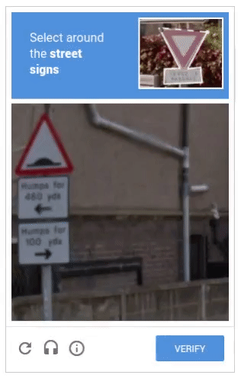
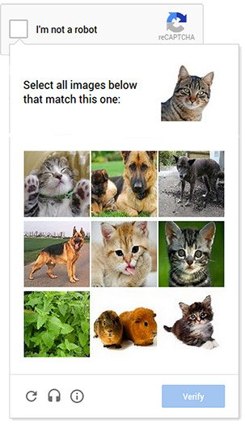
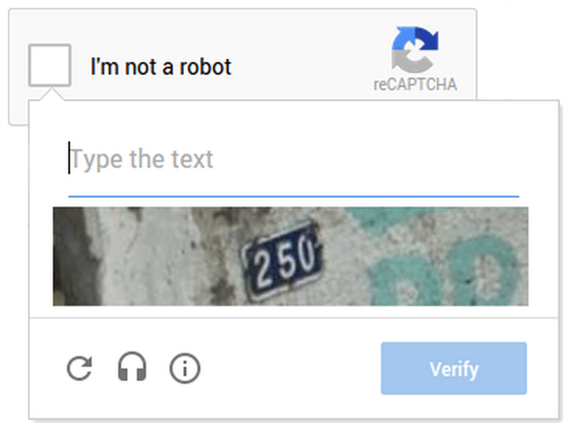
Machine Learning Ex. Google ReCAPTCHA

